Slide 1
CMSC 426 Principles of Computer Security
Malware Categories

Slide 2
Last Class We Covered
Malware
Threat actors
APT groups and others
Attribution
Threat actor examples

Slide 3
Any Questions from Last Time?

Slide 4
Today’s Topics
Types of malware
Well-known malware families
Gratuitous examples of malware

Slide 5
Categorizations
Malware is categorized based on
How it spreads/persists
What it does
What kinds of systems it targets
A single piece of malware can belong to more than one category
Classifications are fuzzy and overlap
These are just general guidelines, not a taxonomy

Slide 6
How Malware Spreads

Slide 7
Worm
Standalone program
Replicates itself and spreads automatically
Attempt to infect as many computers as possible
Normally spread via a network
Consumes bandwidth; dangerous even if “harmless”
Usually exploits a vulnerability to do so
Or captured authorization credentials

Slide 8
Worm Example: Conficker
Exploits the MS08-067 vulnerability (an overflow vulnerability!)
Vulnerability was patched before the worm came out
Still propagating a decade later
Mostly on unpatched legacy systems
Estimated 9 to 15 million computers infected since 2008
The authors of the worm still have not been identified

Slide 9
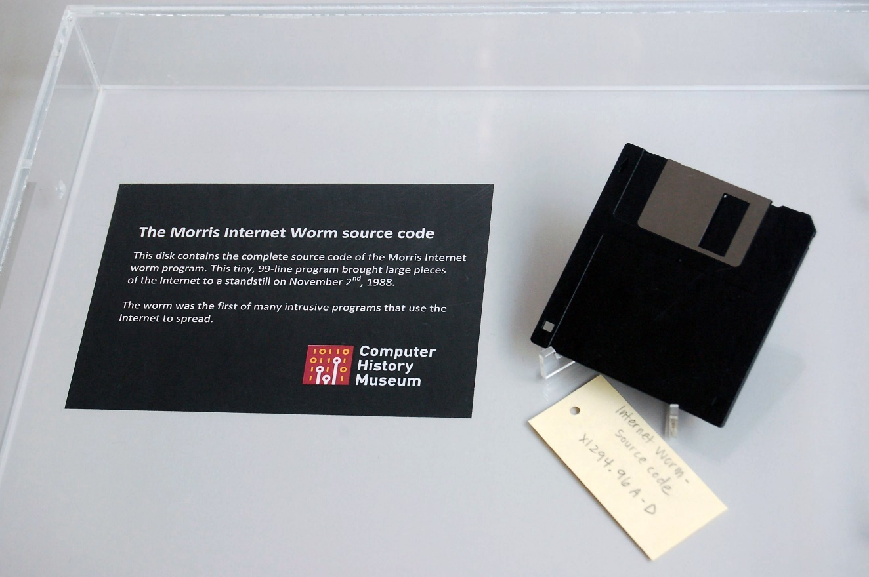
Worm Example: Morris Worm
Released by grad student Robert Morris in November 1988
Claimed it was meant to gauge the size of the Internet
Debate over his true intentions
Infected about 10% of computers connected to the Internet in 1988
Spreading mechanism lead it to re-infect machines, with slowed or crashed them

Slide 10
Worm Example: Morris Worm (cont)
Once it was on a system, it obtained a list of all known hosts that would allow entry from the current host
Then tried to gain access to each one, by either
Attempting to log on as a legitimate user, using a simplified brute force method of password cracking
Exploit a bug in the finger protocol
Exploit the debug option of the mail receiving program
Infected systems would respond they were infected
1 out of 7 times, the worm would propagate regardless

Slide 11
File Infector
Also commonly called a virus
(But not everything is a virus! Watch your language!)
Inserts its own code into executable files to persist and spread
Code is now “infected code”
When the infected executable is run, the virus also executes
Virus is spread when the infected executable is copied onto another system or otherwise spread

Slide 12
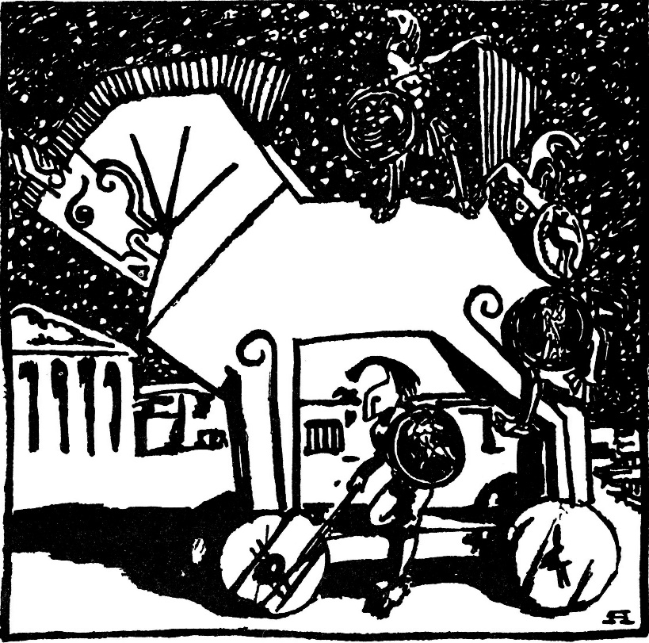
Trojan (or Trojan Horse)
Malicious program that appears to have a useful function
Often spread by social engineering
Executing email attachments
Clicking on advertisements
Payloads can be a variety of things, including backdoors, ransomware, etc.

Slide 13
What Malware Does

Slide 14
Banking Trojan
Trojan that silently “listens” for banking login credentials
Most famous example:
Zeus, which triggered when certain URLs were visited, and inserted JavaScript code into a legitimate bank’s website pages
Estimate of over $100 million in losses/damages since 2007
Source code was leaked in 2011
Other malware authors used this leaked code to create dozens of variant families that are still active today
Information taken from https://www.trendmicro.com/vinfo/us/security/news/cybercrime-and-digital-threats/online-banking-trojan-brief-history-of-notable-online-banking-trojans

Slide 15
Ransomware
Encrypts data and demands payment to decrypt victim’s files
Often asks for payment in cryptocurrency
Cryptocurrency payments are harder to track
Causes billions of dollars in losses/damages each year
Quicker and more direct method of making money than banking Trojans
Don’t have to wait for a user to log into their account

Slide 16
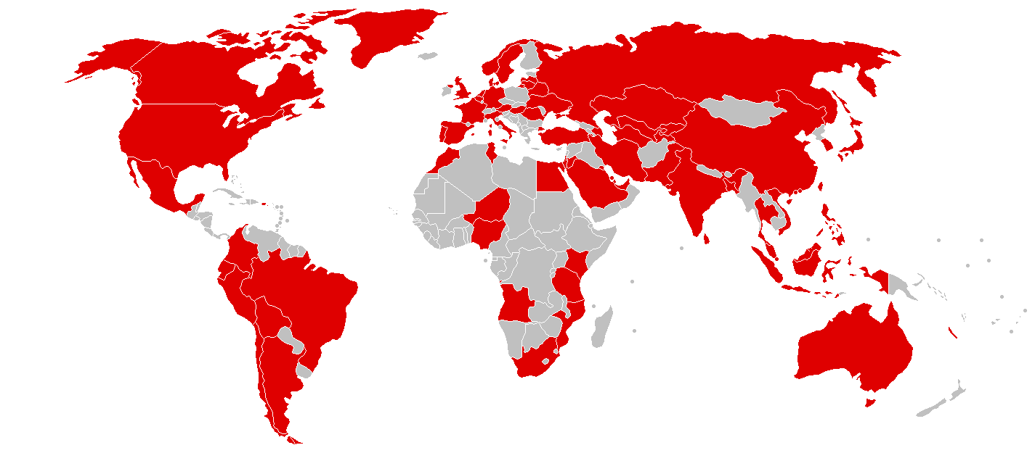
Ransomware Example: WannaCry
Propagated and spread as a worm (not a Trojan)
Uses a leaked NSA-developed exploit to propagate
Exploit called “EternalBlue,” leaked by the Shadow Brokers
Windows released a patch in March 2017
WannaCry was released worldwide in May 2017
Caused billions of dollars in losses and damages

Slide 17
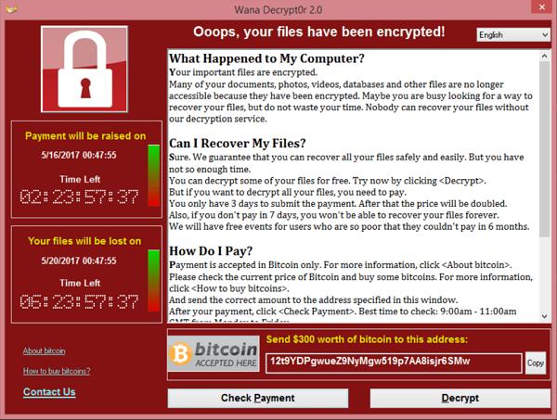
Ransomware Example: WannaCry
200,000 computers infected
$130,000 paid in ransom
Multiple sources have pointed to North Korea as the origin
Lazarus Group
(Also likely responsible for the 2014 Sony email hacks)

Slide 18
Cryptojacking (Cryptocurrency Miners)
Silently mines cryptocurrency for cybercriminals
Uses the victim’s computer without their knowledge
Only sign of infection is slow performance/lagging
Current cybercriminal favorite as of late 2017
Much stealthier and does not require the victim to do anything
January 2018, ads on YouTube containing JavaScript were being used to mine the Monero cryptocurrency
Information taken from https://arstechnica.com/information-technology/2018/01/now-even-youtube-serves-ads-with-cpu-draining-cryptocurrency-miners/

Slide 19
Backdoor (Trapdoor)
Secret entry point into a program
Legitimate tool for debugging and testing (“maintenance hook”)
Used to circumvent long setups or authentication procedures
Can also allow a bad actor to remotely access a computer that has been infected, and bypass the authentication

Slide 20
Remote Access Tool/Trojan (RAT)
“Backdoor on steroids”
Gives actor remote access to, and a high level of control over, the infected computer
Example of RAT:
Poison Ivy, which can log keystrokes, spy on the victim’s actions, steal password hashes, transfer files, etc.
Since 2008, many different APT groups have used Poison Ivy variants in their campaigns
Very popular tool, simple to use
Information from https://www.fireeye.com/content/dam/fireeye-www/global/en/current-threats/pdfs/rpt-poison-ivy.pdf

Slide 21
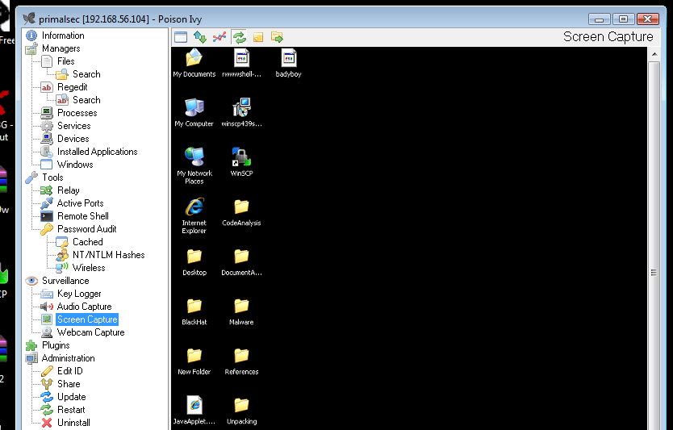
RAT Example: Poison Ivy
Screenshot of Poison Ivy use, showing victim’s screen within the GUI framework
Image from http://www.primalsecurity.net/poison-ivy-remote-access-tool-rat/

Slide 22
Botnet
Refers to a large number of computers being controlled simultaneously by a single actor
Anywhere from a few thousand to a few million
Often used to send spam emails and launch DDoS attacks
Differs from RAT, where the actor has fine control of a machine
With a botnet, the actor can give commands to many machines
Different desired outcomes, different means of achieving them

Slide 23
Credential Stealer
Attempt to steal the victim’s credentials
Usually done using one of these methods:
Keylogging
(Or spyware in general)
Dumping and extracting from password hashes

Slide 24
Rootkit
Set of programs that maintains covert access to that system
Normally with administrator (root) privileges
Actively masks its existence within the system
Two types: user mode and kernel mode
User mode runs at same level as other user applications
e.g., Intercepts calls to APIs to prevent listing its files in a directory
Kernel mode runs with the highest privileges
e.g., Adds or replaces portions of the OS itself

Slide 25
Wiper
Wipes the hard drive of the infected system
Recent example: NotPetya
Originally classified as a ransomware worm that spread by exploiting EternalBlue in 2017
Seemed to be a variant of the Petya ransomware
Encrypts parts of the master boot record and intentionally makes system unrecoverable, even if the ransom is paid
Now classified as a wiper/worm

Slide 26
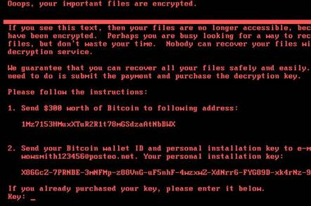
Wiper Example: NotPetya
Heavily targeted computers in Ukraine, caused over $10 billion in damages
One of the costliest, if not the costliest cyberattack to date
Attributed to the Sandworm APT group, which is Russian state-sponsored
Image from https://www.theregister.co.uk/2017/06/28/petya_notpetya_ransomware/

Slide 27
What Systems Malware Targets

Slide 28
Mobile Malware
Malware that targets mobile devices
Common in 3rd-party app stores
Growing category of malware and much more prevalent in countries that do not allow access to official app stores
Antivirus programs are largely ineffective, due to the rapid evolution of mobile malware

Slide 29
Point-of-sale Malware
Malware that targets PoS devices like cash registers
Goal is to obtain credit card and debit card information
Often scrapes RAM of PoS devices to accomplish this
Simplest and most evasive way to obtain the data

Slide 30
SCADA Malware
Stands for “Supervisory Control and Data Acquisition”
SCADA systems allow high-level process supervising
Often used for industrial, infrastructure, and facility purposes
Manufacturing, power plants, refineries
Water treatment, oil pipelines, electric power distribution, etc.
Airports, buildings, ships (HVAC, access, etc.)
Obviously, malware that targets these systems can cause widespread physical damage

Slide 31
SCADA Malware Example: Stuxnet
SCADA worm that targeted Iran’s nuclear program in 2010
Centrifuges in nuclear plants spun too fast and tore themselves apart
Estimated to have damaged or destroyed approximately 20% of the nuclear plants in Iran
Was introduced to systems via a USB drive
Spreads by exploiting four different zero day exploits
First known malware that targets industrial systems
One of the earliest instances of causing widespread physical damage via malware

Slide 32
Announcements
Schedule is now up on the course website
First midterm pushed back to Tuesday, October 9th
General topics laid out for rest of semester
Assignments page also up to date
All assignments have release and due dates
Lab 1 and Paper 1 are due at midnight on Wednesday, September 26th

Slide 33
Image Sources
Morris worm disk (adapted from):
https://www.flickr.com/photos/intelfreepress/10483246033
Trojan horse:
https://commons.wikimedia.org/wiki/File:Trojan_Horse_by_A_Yakovlev_1911.jpg
WannaCry screenshot:
https://en.wikipedia.org/wiki/File:Wana_Decrypt0r_screenshot.png

